Slide 1

Simulation-Based Inference for Parameter Identification in Mechanistic Models of Neural Dynamics
Nicolai Haug
December 13, 2021
Supervisors
Gaute Einevoll
Joakim Sundnes
Aslak Tveito
Alexander Stasik
Notes:
Title
Supervisors

Slide 2
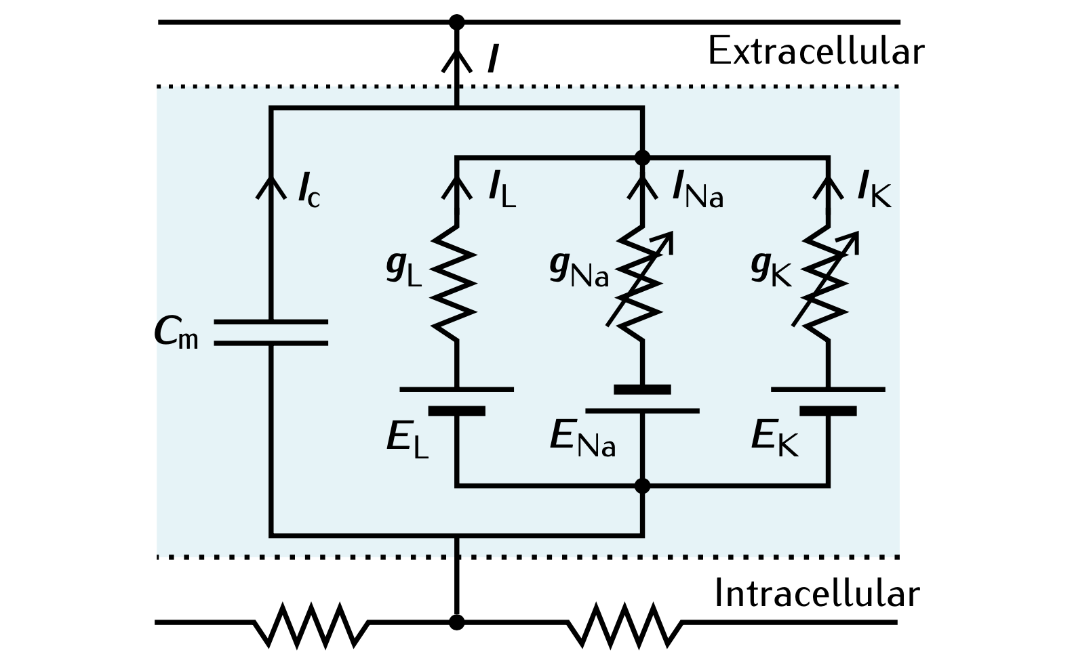
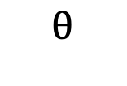
Mechanistic model
Record data from neural process
Model data-generating process in terms of causal mechanisms
PREDICTION
INFERENCE
$$θ$$
Model parameters
Challenge: Identify data-compatible model parameters

Slide 3
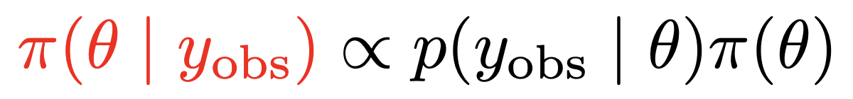
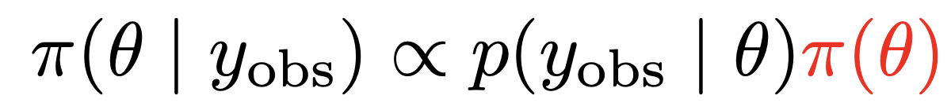
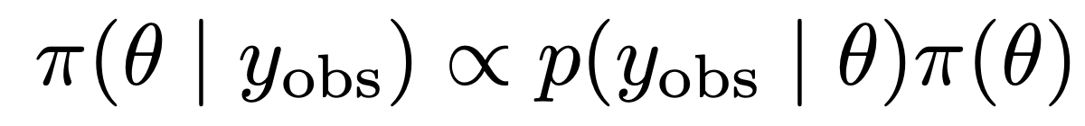
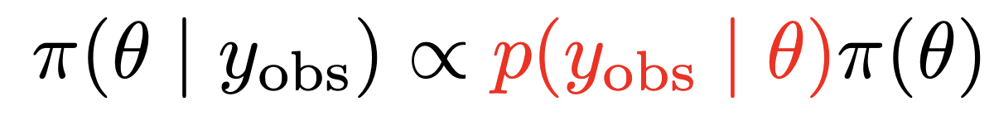
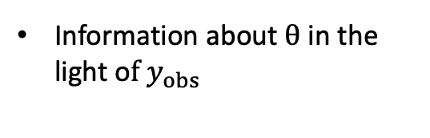
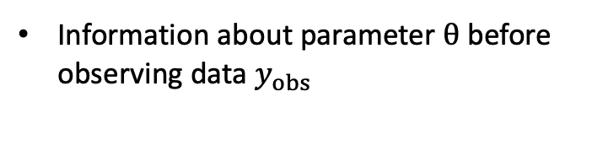
Bayesian Inference
Model beliefs using statistical distributions
Unknown parameters are treated as random variables
Enables uncertainty quantification
Update prior beliefs into posterior beliefs when observing data
Bayes’ theorem
Posterior
Likelihood
Prior
Information about $θ$ in the light o$f y_{obs}$
Statistical model of data-generating process
Information about parameter $θ$ before observing data $y_{obs}$

Slide 4
Evaluation of likelihood seems like a basic requirement ….
However, likelihoods are generally intractable for mechanistic models
How can we do Bayesian inference for mechanistic models?
How can we do Bayesian inference for mechanistic models?
Possible solution: Simulation-Based Inference (SBI)
Also called Likelihood-Free Inference (LFI)
Avoid explicit likelihood evaluations
Use model simulations instead
Objective of thesis:
Investigate the ability and utility of SBI for identifying parameters in mechanistic models of neural dynamics

Slide 5
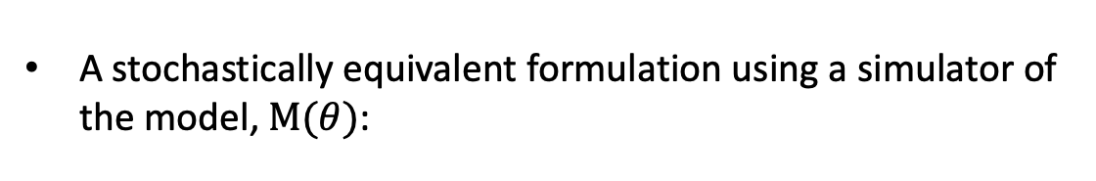
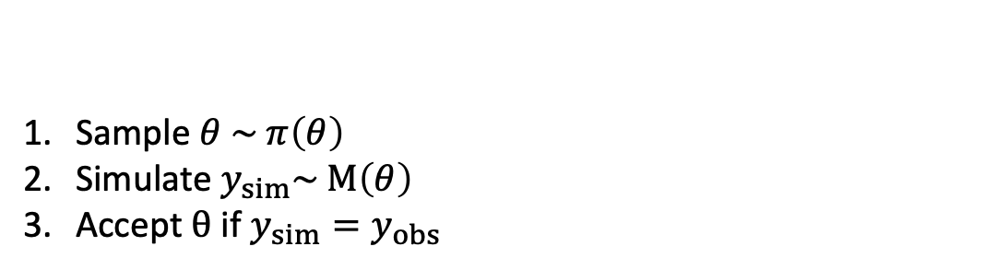
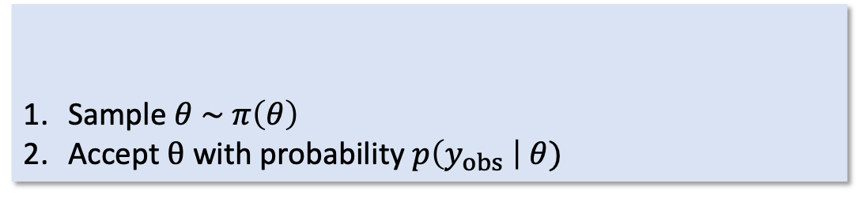
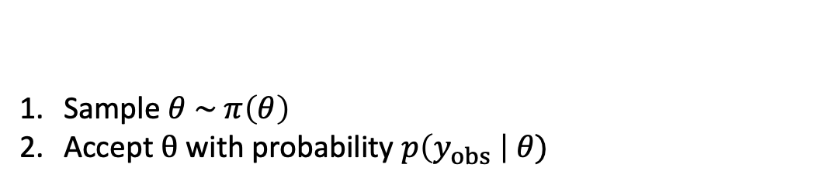
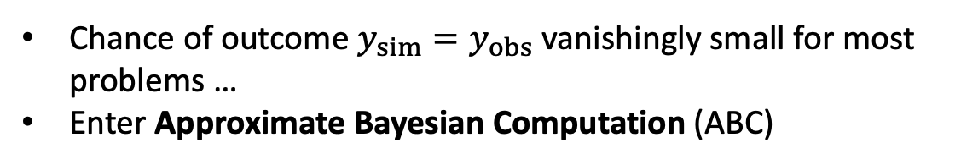
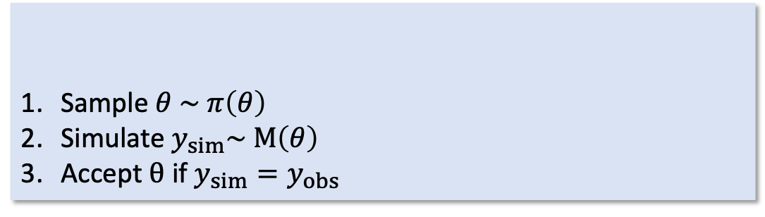
Want an algorithm that enables sampling from the posterior
In the likelihood-based context:
Sample $θ \sim π\left(θ\right)$
Accept $θ$ with probability $p\left(y_{obs} \right| θ)$
Rejection Algorithm
Sample $θ \sim π\left(θ\right)$
Accept $θ$ with probability $p\left(y_{obs} \right| θ)$
Rejection Algorithm
A stochastically equivalent formulation using a simulator of the model, $M(θ)$:
Sample $θ \sim π\left(θ\right)$
Simulate $y_{sim}\sim M\left(θ\right)$
Accept $θ$ if $y_{sim}=y_{obs}$
Sample $θ \sim π\left(θ\right)$
Simulate $y_{sim}\sim M\left(θ\right)$
Accept $θ$ if $y_{sim}=y_{obs}$
“Mechanistic” Rejection Algorithm
“Mechanistic” Rejection Algorithm
Chance of outcome $y_{sim}=y_{obs}$ vanishingly small for most problems …
Enter Approximate Bayesian Computation (ABC)

Slide 6

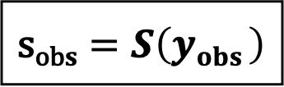

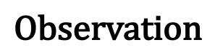

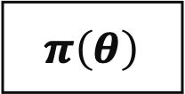
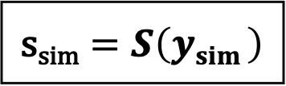

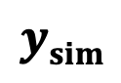
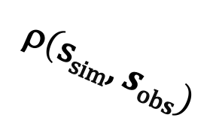
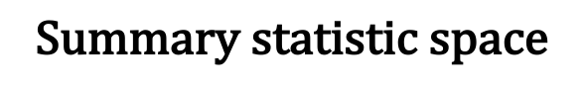
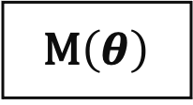
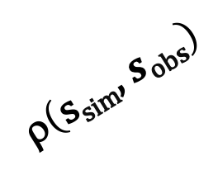
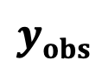
Rejection ABC
$$\text{Summary} \text{statistic} \text{space}$$
$$yobs$$
$$ε$$
$$\text{Observation}$$
$$\text{s}\text{ob}s=S\left(yobs \right)$$
$$\text{}\left(\text{s}\text{sim}\text{, }s\text{ob}s\right)$$
$$\text{}\left(\text{s}\text{sim}\text{, }s\text{ob}s\right)$$
$$\text{Accepted}$$
$$θ$$
$$ysim$$
$$π\left(θ\right)$$
M$\left(θ\right)$
$$\text{s}\text{sim}=S\left(ysim \right)$$
$$\text{R}\text{ejected}$$

Slide 7
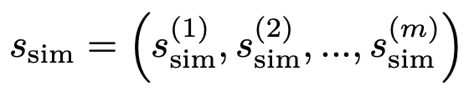
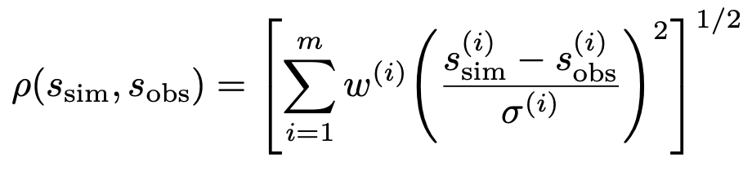
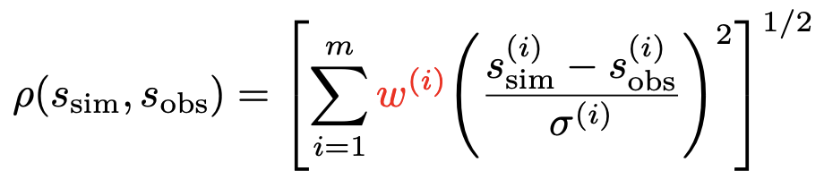
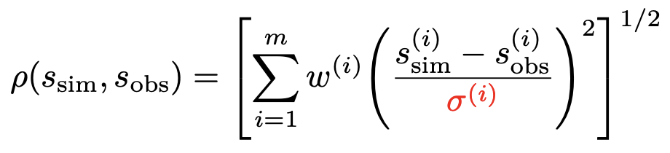
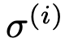
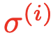
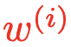
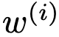
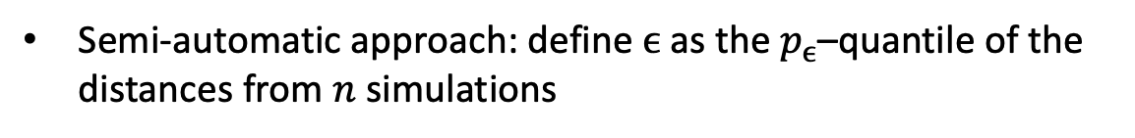
ABC Configuration
Distance metric
Each simulation results in
Use a weighted Euclidean distance to measure discrepancy:
– estimator of the $i$th summary statistic scale
– importance weight of the $i$th summary statistic
Tolerance selection
Determining a “good” tolerance $ϵ$ manually can be difficult
Semi-automatic approach: define $ϵ$ as the $p_{ϵ}$–quantile of the distances from $n$ simulations
0.5-quantile means we accept 50% of simulations , 0.3-quantile 30% etc.

Slide 8
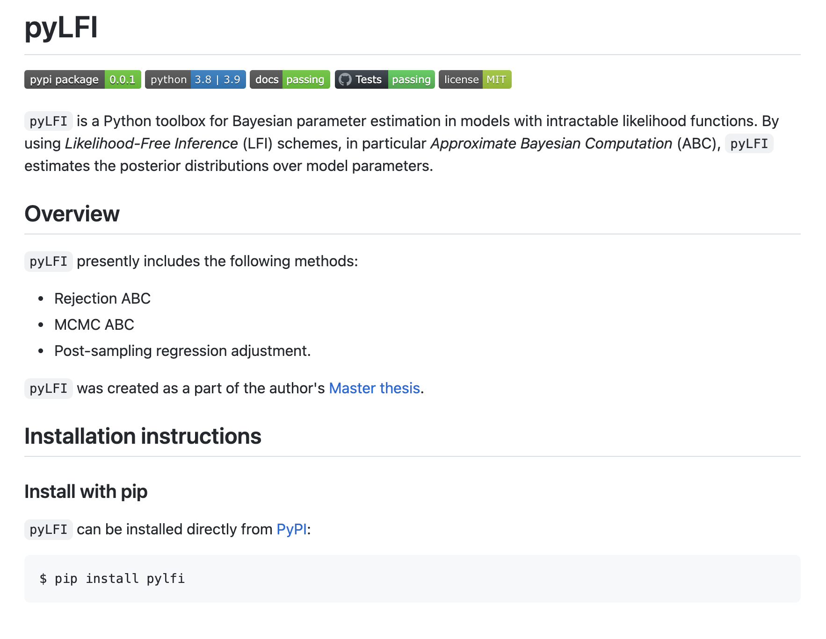
github.com/nicolossus/pylfi

Slide 9
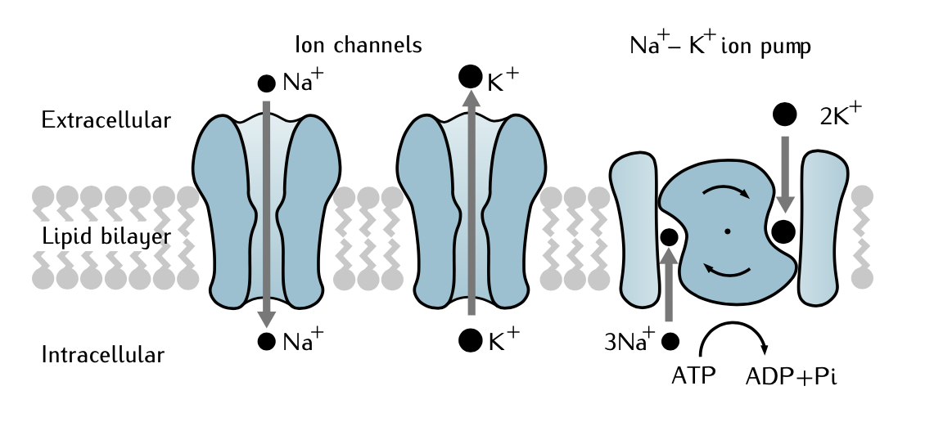
The Hodgkin-Huxley (HH) Model
Biophysically detailed model of ionic mechanisms underlying action potential (AP) initiation and propagation in neurons
HH treated the squid giant axon as an equivalent circuit
Inferential task: Identify the active conductance parameters

Slide 10
Choice of Summary Statistics
Informative summary statistics crucial for good performance
Set of summary statistics must be low-dimensional
Use expert-crafted summary statistics
Average AP overshoot
Average AHP depth
Accommodation index
Average AP width
Latency to first spike
Spike rate

Slide 11
Insert NeuroModels image

Slide 14
Rejection ABC Posterior

Slide 15
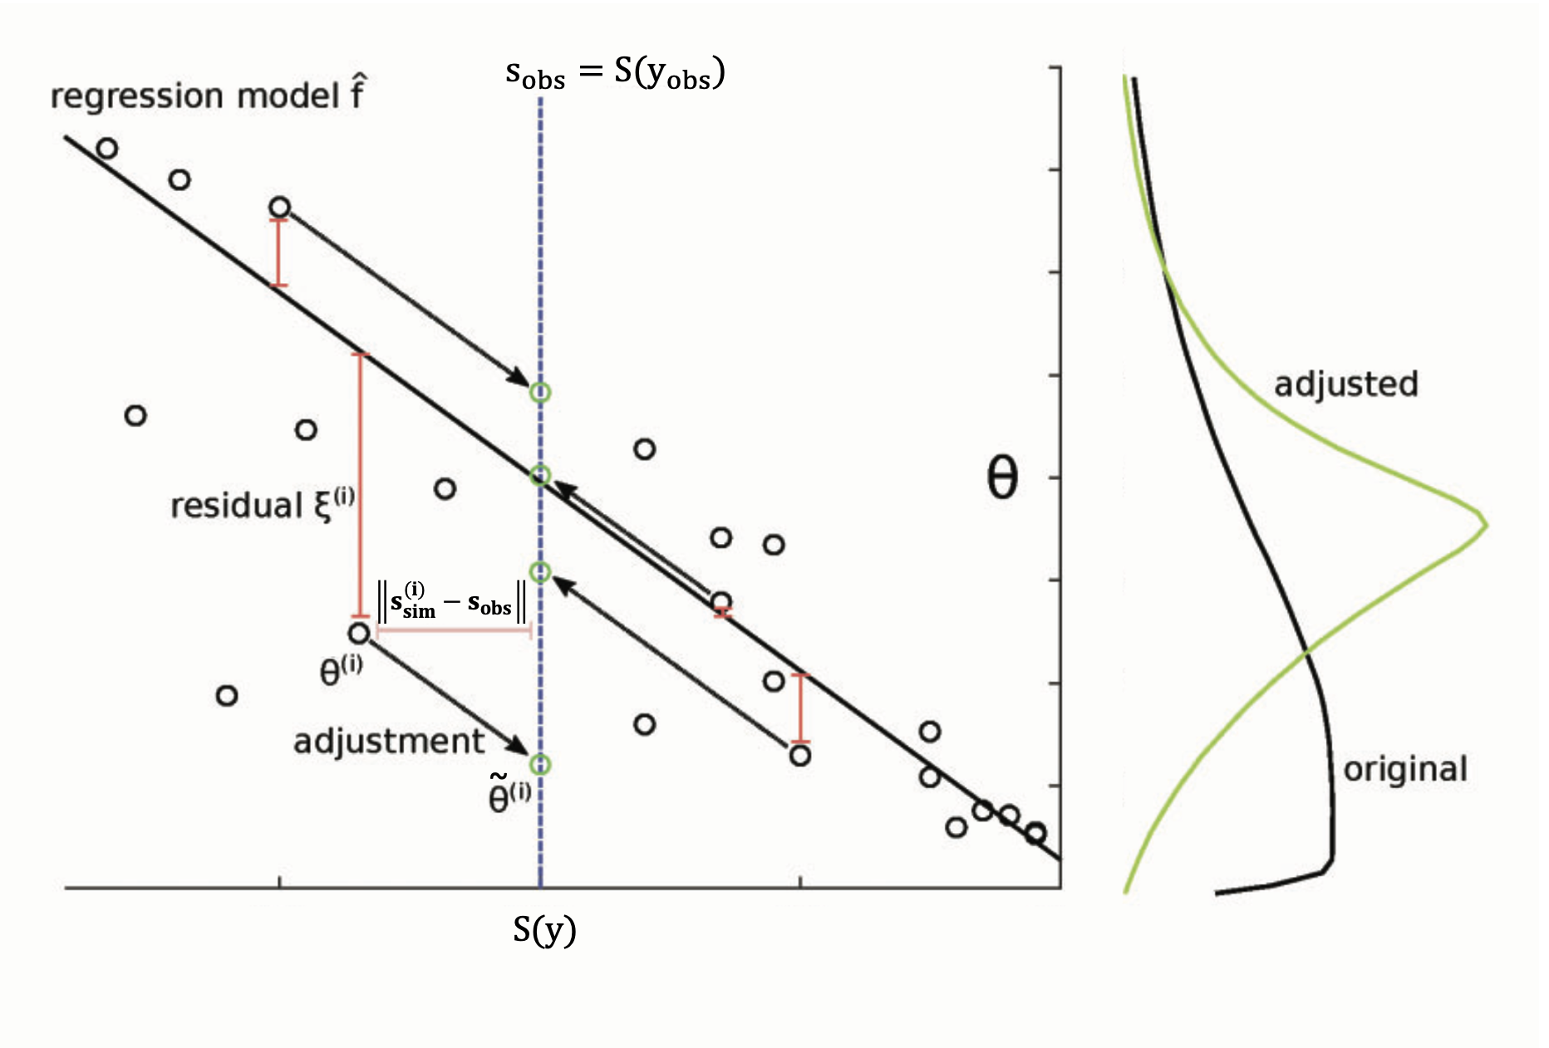
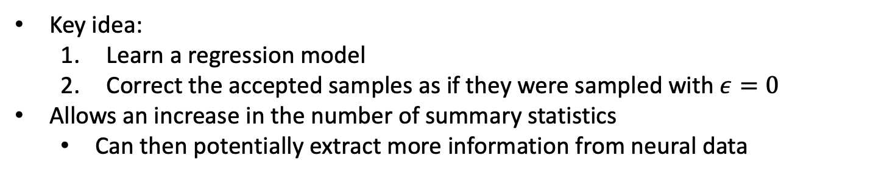
Regression Adjustment
Key idea:
Learn a regression model
Correct the accepted samples as if they were sampled with $ε=0$
Allows an increase in the number of summary statistics
Can then potentially extract more information from neural data

Slide 16
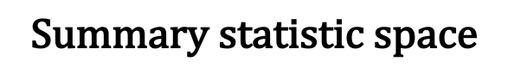


Local Linear Regression Adjustment
Parameters that result in simulations closer to observation should be weighted more heavily than those further away
$$\text{Summary} \text{statistic} \text{space}$$
$$ε$$
$$\text{Accepted}$$

Slide 17
Tuning parameters pt. 1

Slide 18
Tuning parameters pt. 2

Slide 19
Original ABC Posterior
Adjusted ABC Posterior

Slide 20
Posterior Predictive Check
Draw 100 samples from posterior and feed the parameters to the HH simulator
Then take the average of the simulated voltage traces

Slide 21
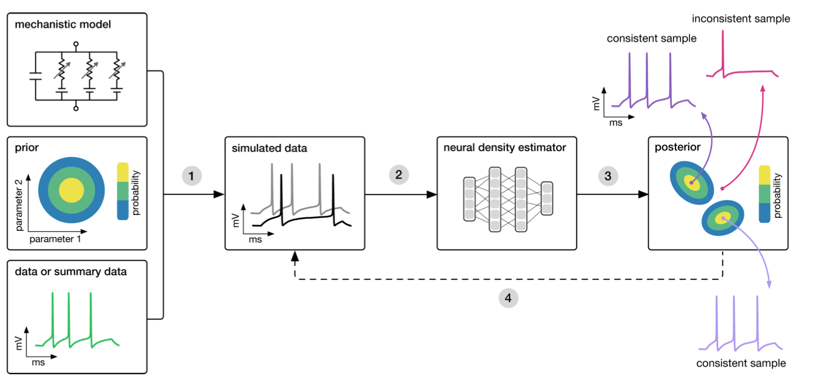
Sequential Neural Posterior Estimation (SNPE)
A neural density estimation algorithm
That is, a density estimator based on specialized artificial neural networks (ANNs)
Instead of filtering out simulations, as ABC does, SNPE trains on all model simulations
Mackelab

Slide 22
Adjusted ABC Posterior
SNPE Posterior

Slide 23
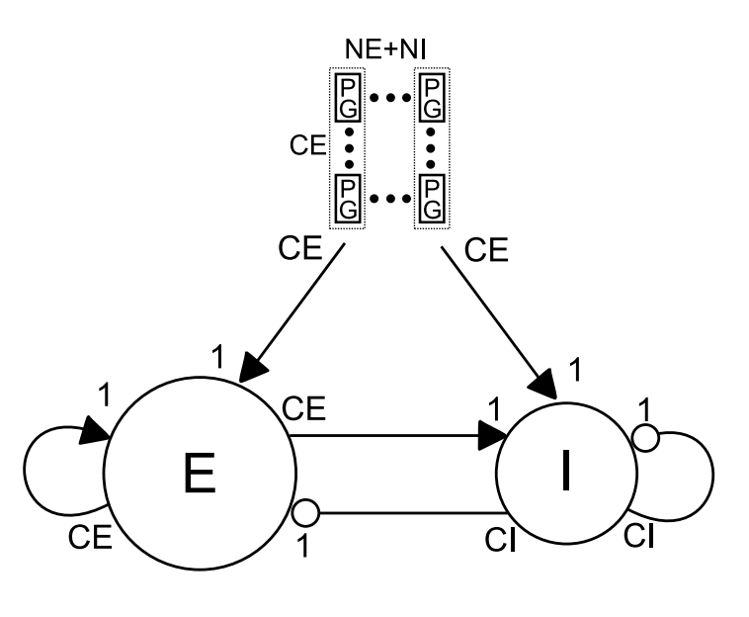
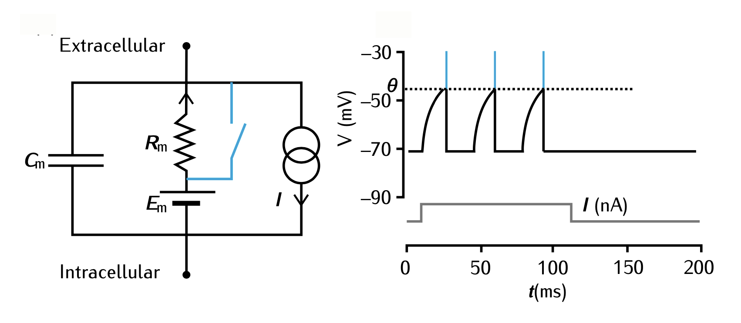
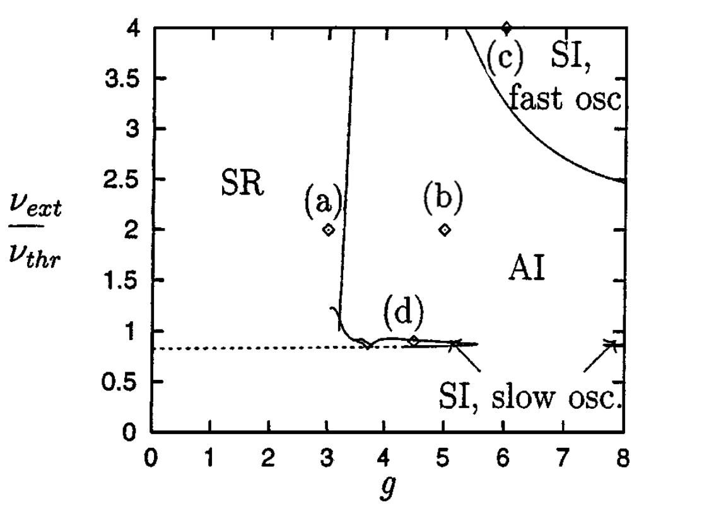
The Brunel Network Model

Slide 25
Observation from AI state
Adjusted ABC Posterior

Slide 26
Posterior Predictive Check

Slide 27
Observation from AI state
Adjusted ABC Posterior
SNPE Posterior

Slide 28
Observation from SR state
SNPE Posterior

Slide 29
Summarize key findings
SBI is well-suited for many computational investigations
We found a principled approach
Outlook
Explore higher-dimensional problems

